Slide 1
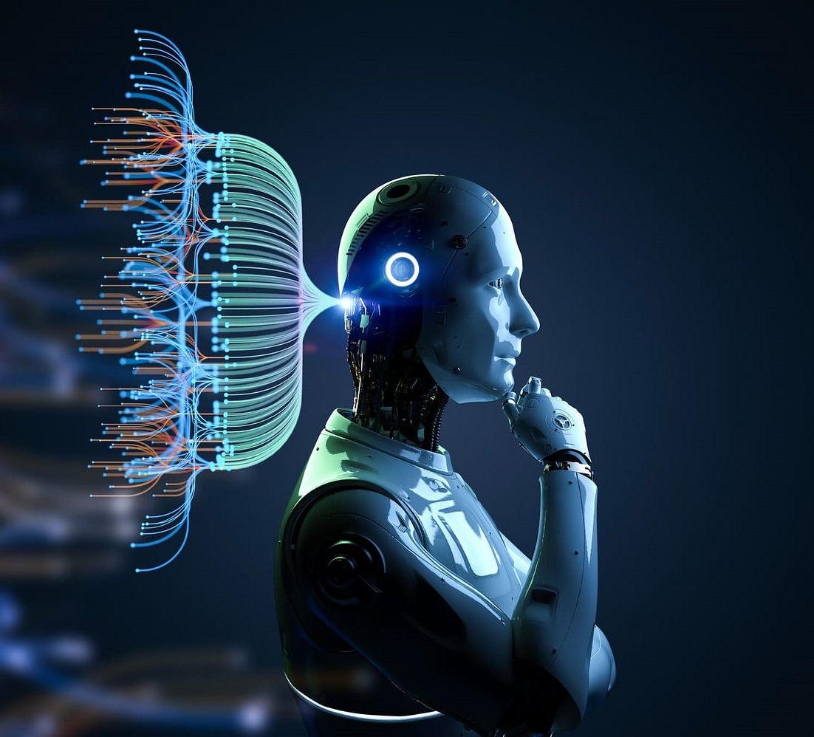
Introduction to Machine Learning in Healthcare
PREDICTION OF RE-ADMISSION WITHIN 30 DAYS AFTER A DIABETIC ENCOUNTER DISCHARGE

Slide 2
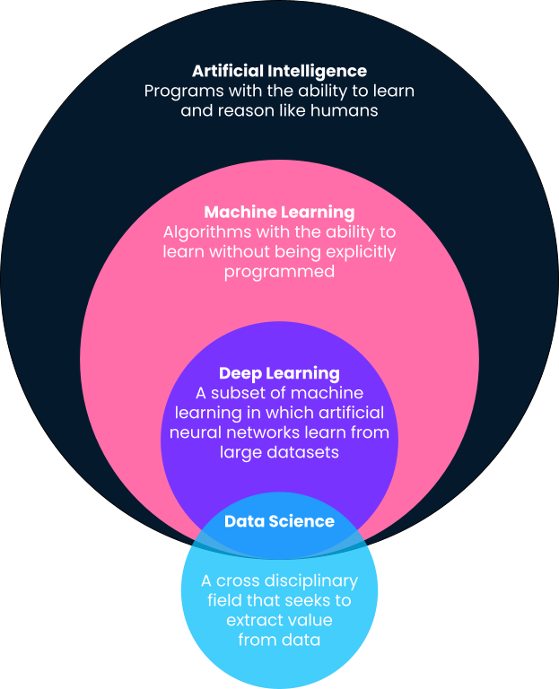
The power of the future!
Machine Learning VS AI
MACHINE LEARNING IS A SUBFIELD OF AI!
Artificial Intelligence (AI) - deals with making machines simulate human cognitive abilities and actions without human assistance
Machine learning - concerned with making machines learn patterns from the available data so that it can then make predictions on unseen data.

Slide 3
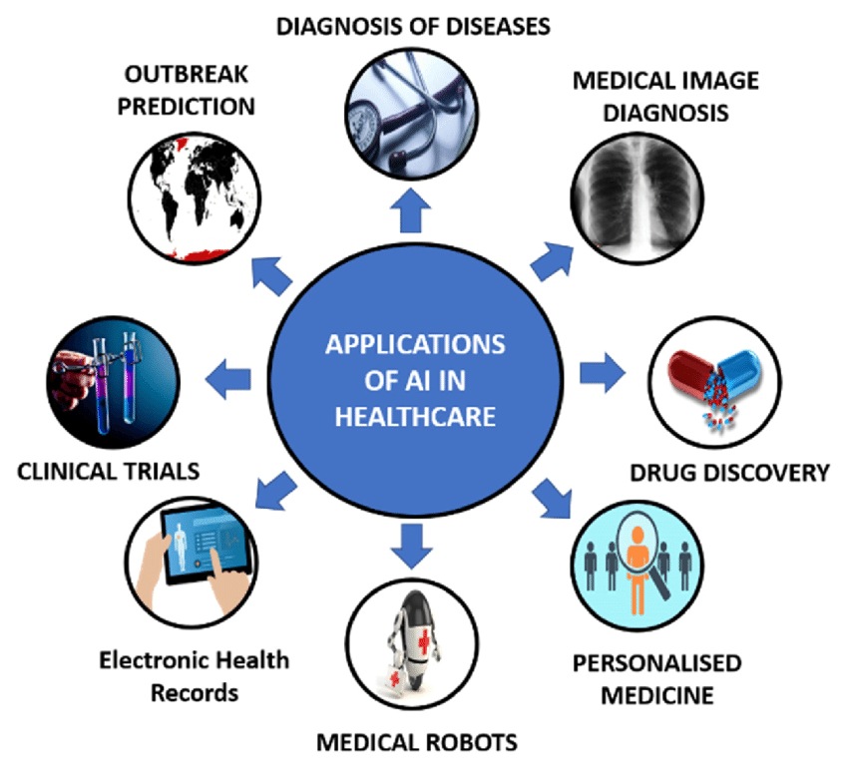
The power of the future!
Impact of Machine Learning
Diagnosis + Disease Prediction
Medical Imaging
Drug discovery
Personalized Medicine
Patient Monitoring
Hospital management & optimization
Administrative Efficiency

Slide 4
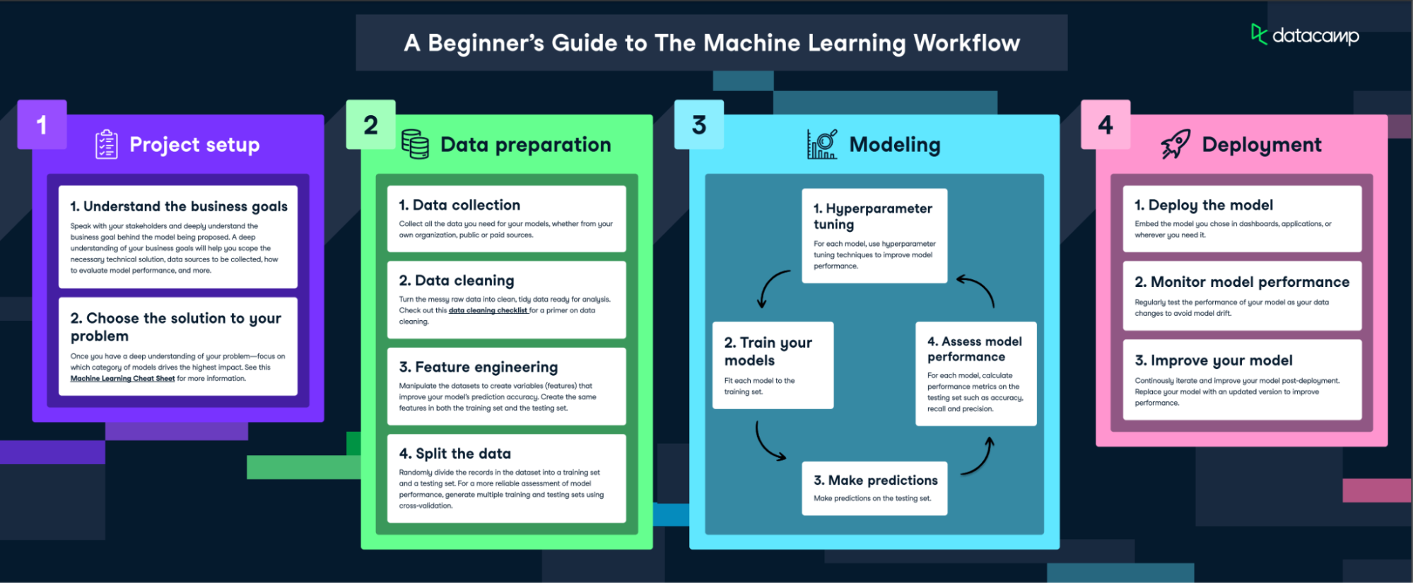
The power of the future!
How does Machine Learning Work?

Slide 5
LET’S PASS FROM THEORY
INTO PRACTICE!
IMLH FINAL PROJECT

Slide 6


OBJECTIVE
INTRODUCTION
DATASET DESCRIPTION
The dataset from the UCI Machine Learning Repository, specifically "Diabetes 130-US hospitals for years 1999-2008," includes diabetic patient records from 130 US hospitals (1999-2008).
It contains patient demographics, medical records, hospital information, and clinical measurements.
Our goal is to optimize a machine learning model that can predict re-admission within 30 days after a diabetic encounter discharge.

Slide 7
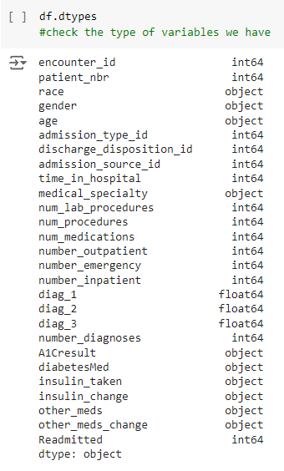
VARIABLES
81 176 cases
27 variables
9 numerical
18 categorical

Slide 8
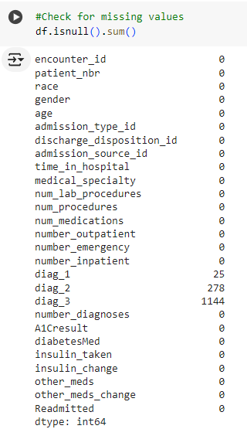

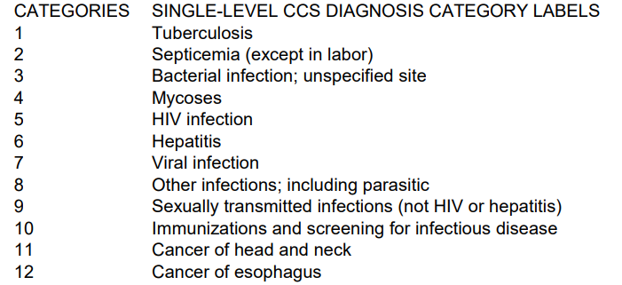
MISSING VALUES
Missing values → “Unknown”
Are diag_1, diag_2 and diag_3 just values in a numerical variable? What do they mean?
The numbers are coded as CCS:
This variable is not numerical but CATEGORICAL!

Slide 9
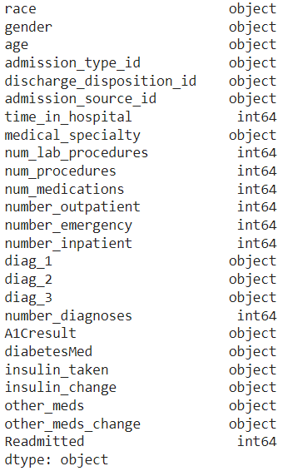
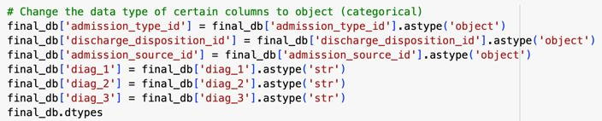
NUMERICAL TO CATEGORICAL VARIABLES

Slide 10
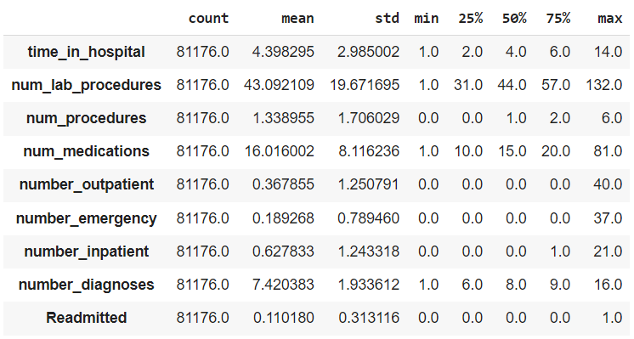
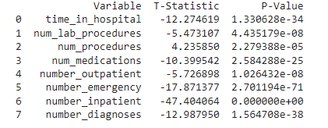
DESCRIPTION AND ANALYSIS OF NUMERICAL VARIABLES
T-TEST

Slide 11
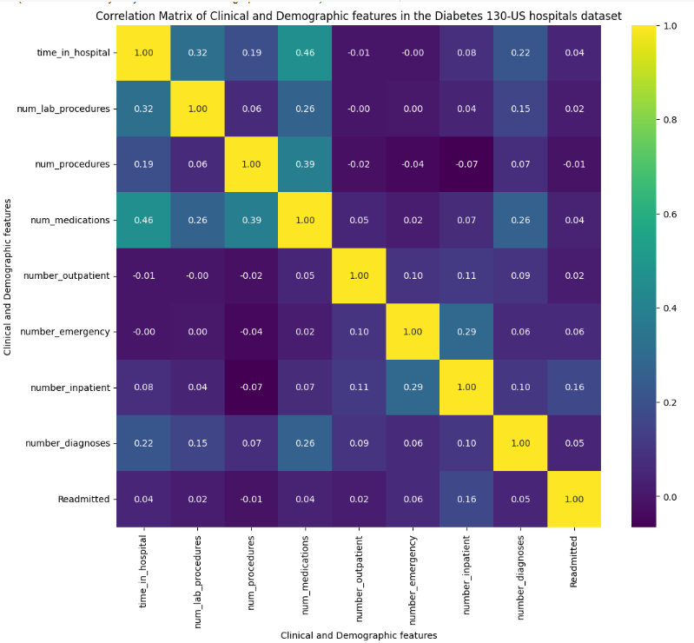
DESCRIPTION OF NUMERICAL VARIABLES
CORRELATION MATRIX

Slide 12
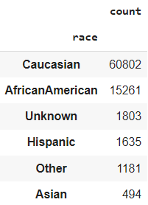
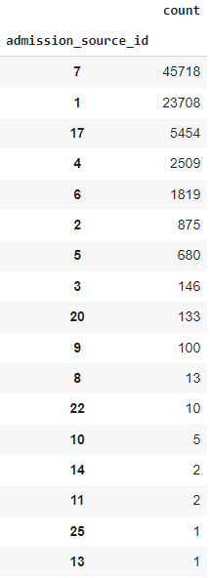
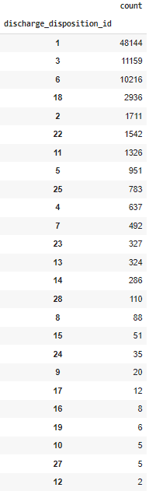
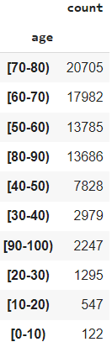
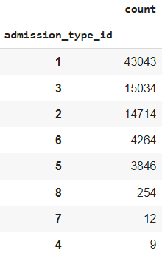
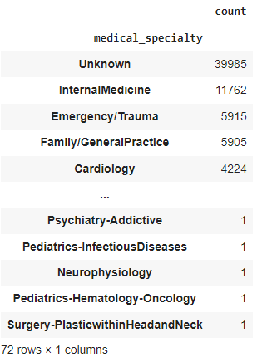
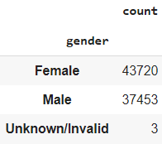
DESCRIPTION OF CATEGORICAL VARIABLES

Slide 13
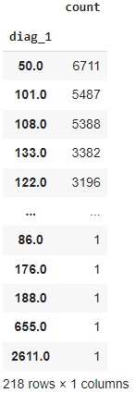
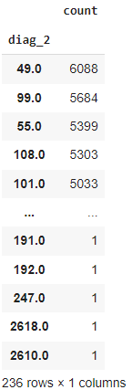
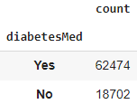
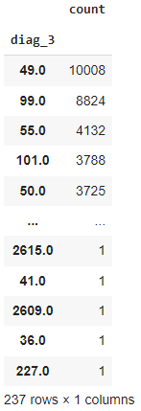
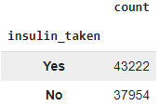
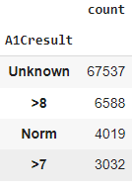
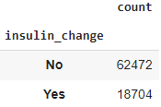
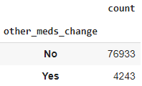
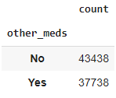
DESCRIPTION OF CATEGORICAL VARIABLES

Slide 14
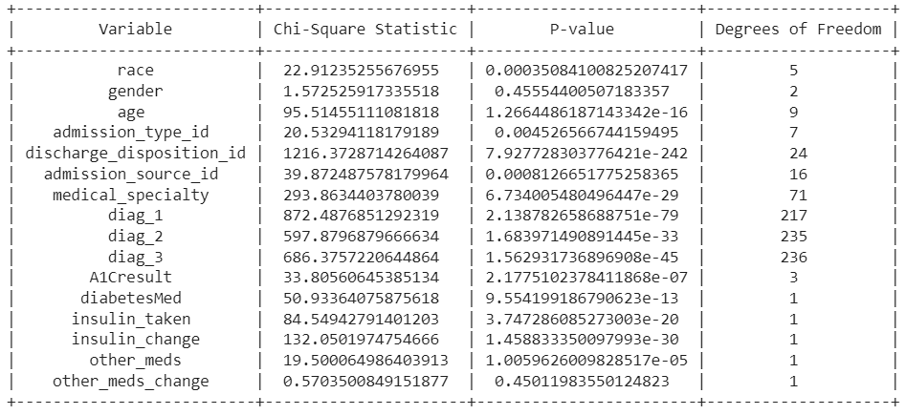
ANALYSIS OF CATEGORICAL VARIABLES
CHI-SQUARE TEST

Slide 15
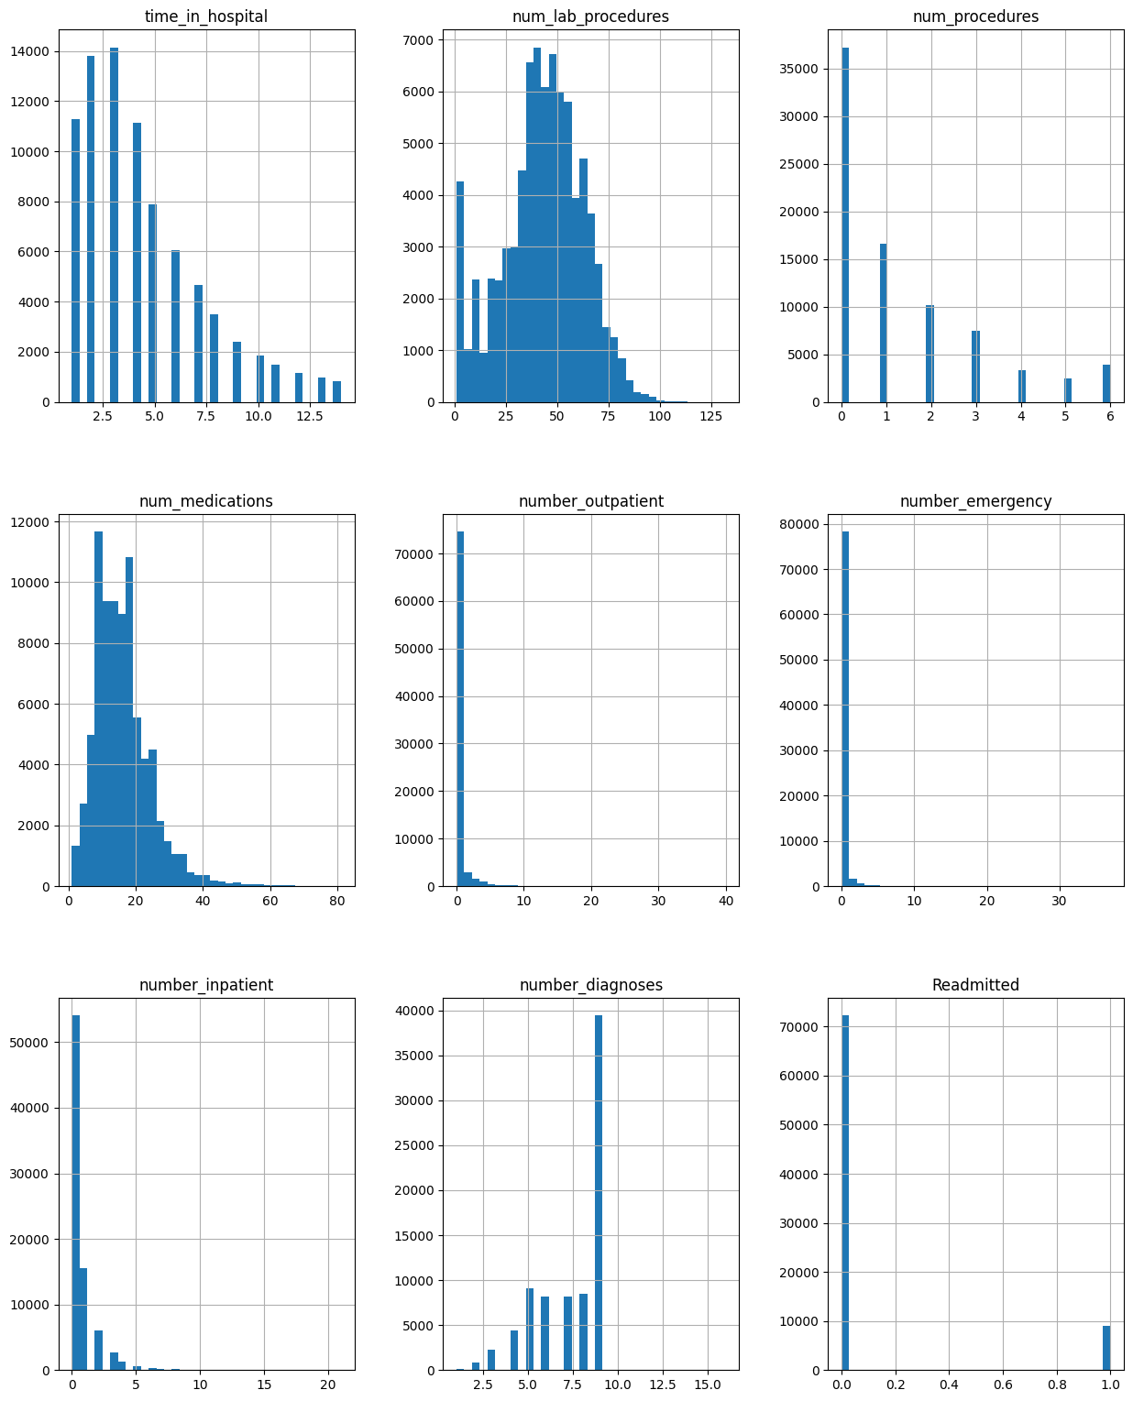
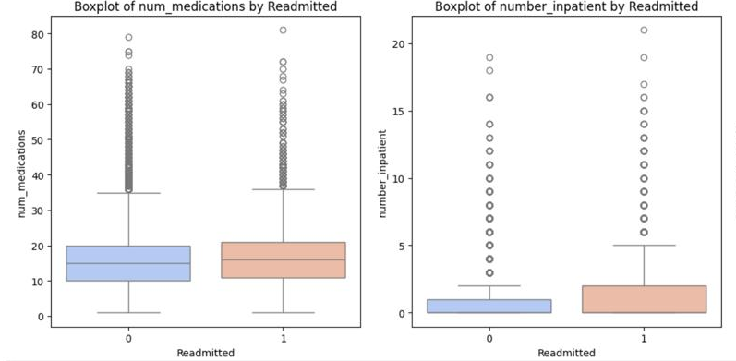
VISUALIZATION
BOX-PLOTS AND HISTOGRAMS

Slide 16
MODELING
TRAINING + VALIDATION

Slide 17
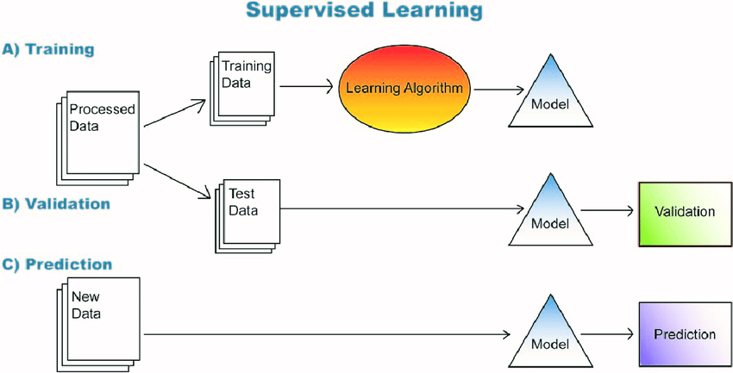
It is about training!
THE PROCESS

Slide 18
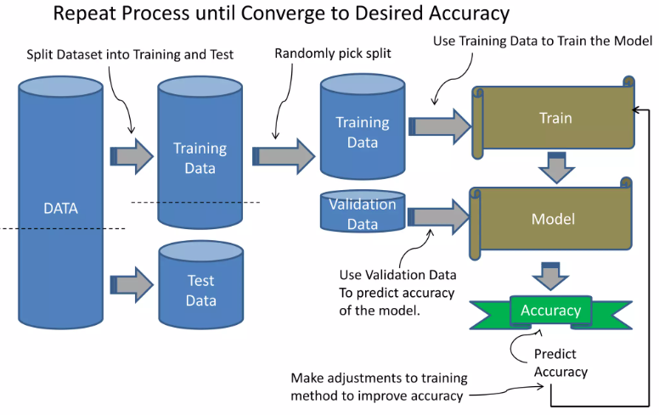
It is about training!
THE PROCESS
To use a dataset in Machine Learning, the dataset is first split into a training and test set.
The training set is used to train the model.
The test is used to test the accuracy of the model.
Typically, split 80% training, 20% test.

Slide 19
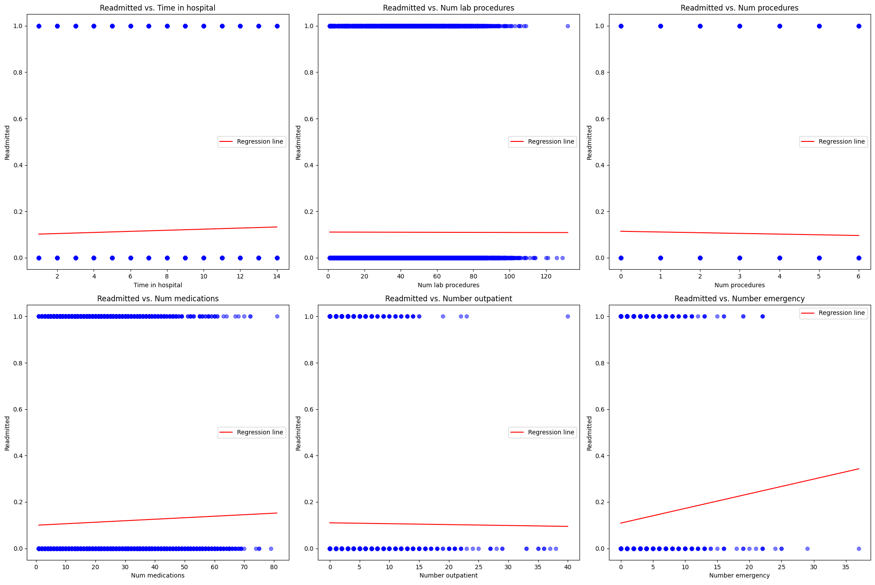
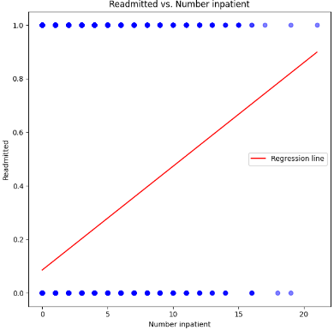
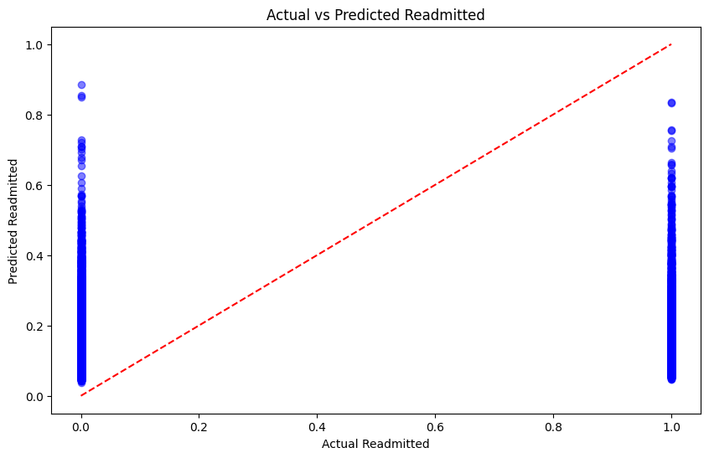
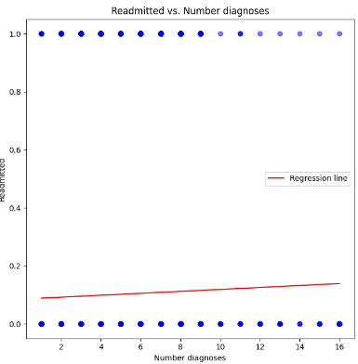
The easiest one, but useless…
LINEAR REGRESSION
M.S.Error: 0.10
R^2 Score: 0.03

Slide 20
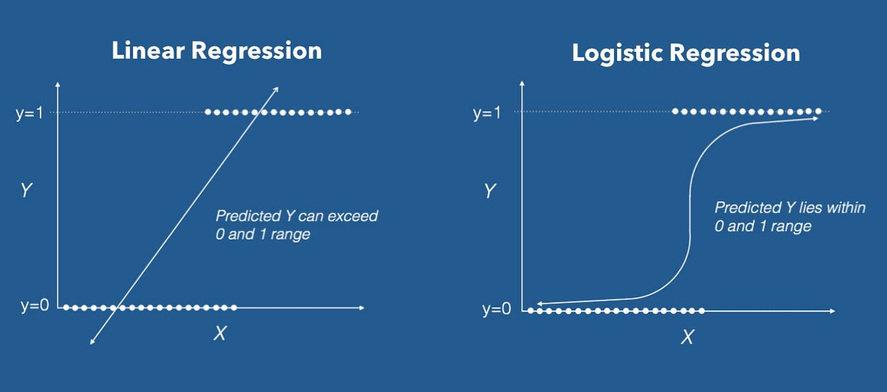

Slide 21
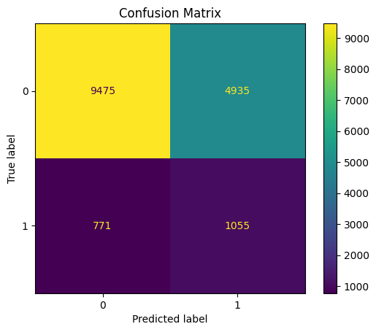
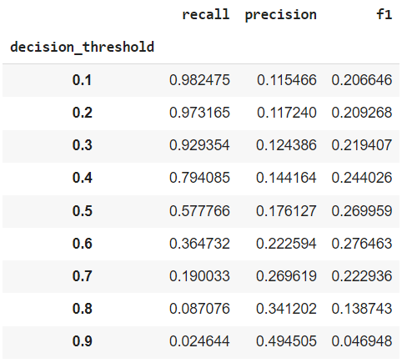
LOGISTIC REGRESSION
Threshold = 0.5
Accuracy: 0.65
Recall: 0.58
Precision: 0.18
F1-Score: 0.27

Slide 22
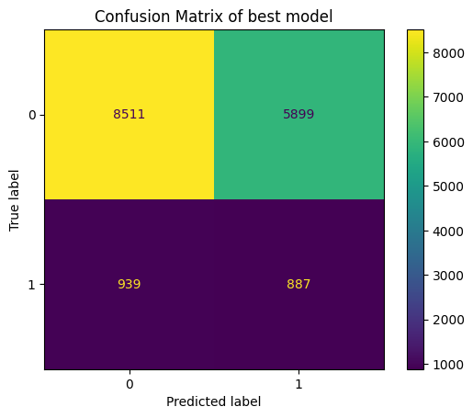
DECISION TREES
Accuracy: 0.58
Recall: 0.49
Precision: 0.13
F1-Score: 0.21

Slide 23
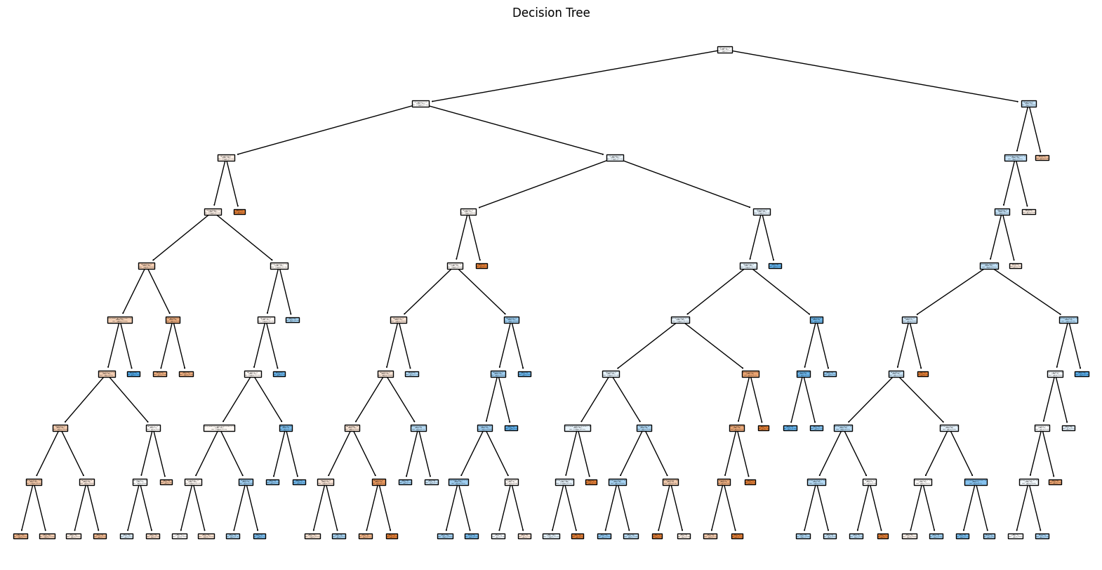
Decision tree of the best model
DECISION TREES

Slide 24
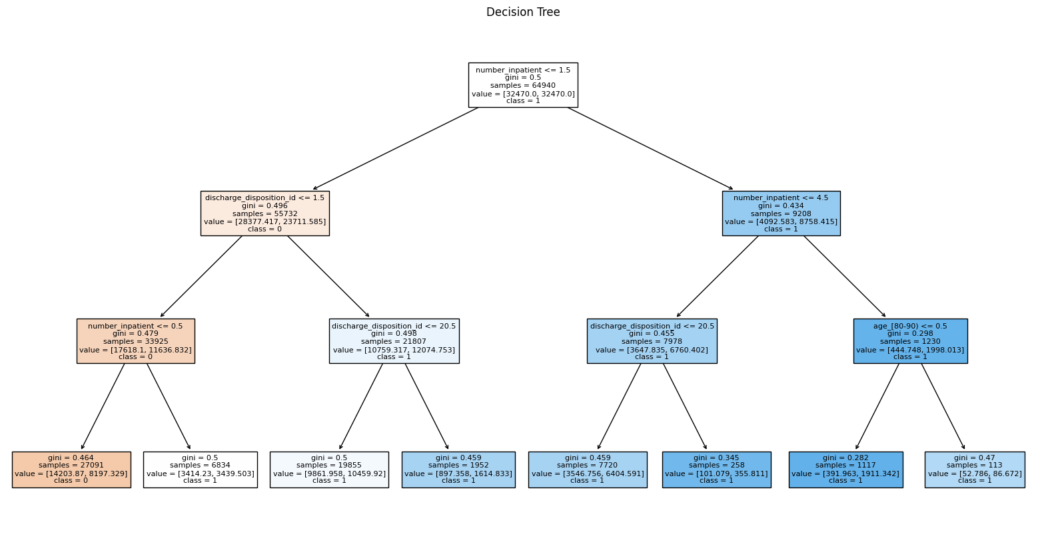
Decision tree from the pruned decision tree classifier -> limiting depth of tree
DECISION TREES

Slide 25
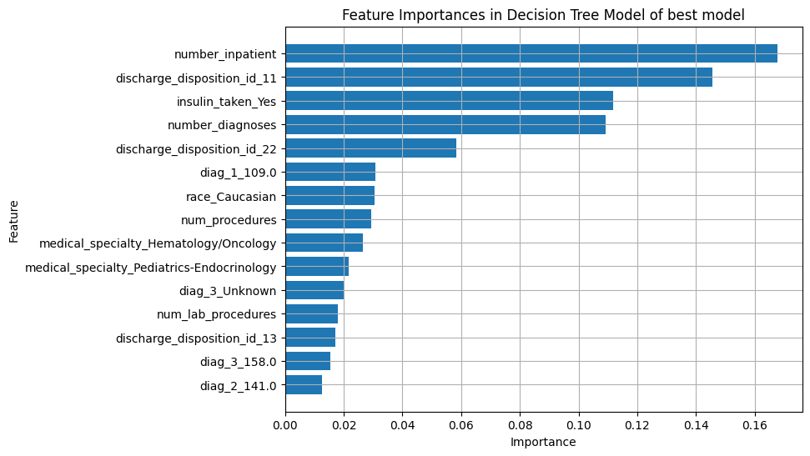
Feature importance in decision tree of best model
DECISION TREES

Slide 26
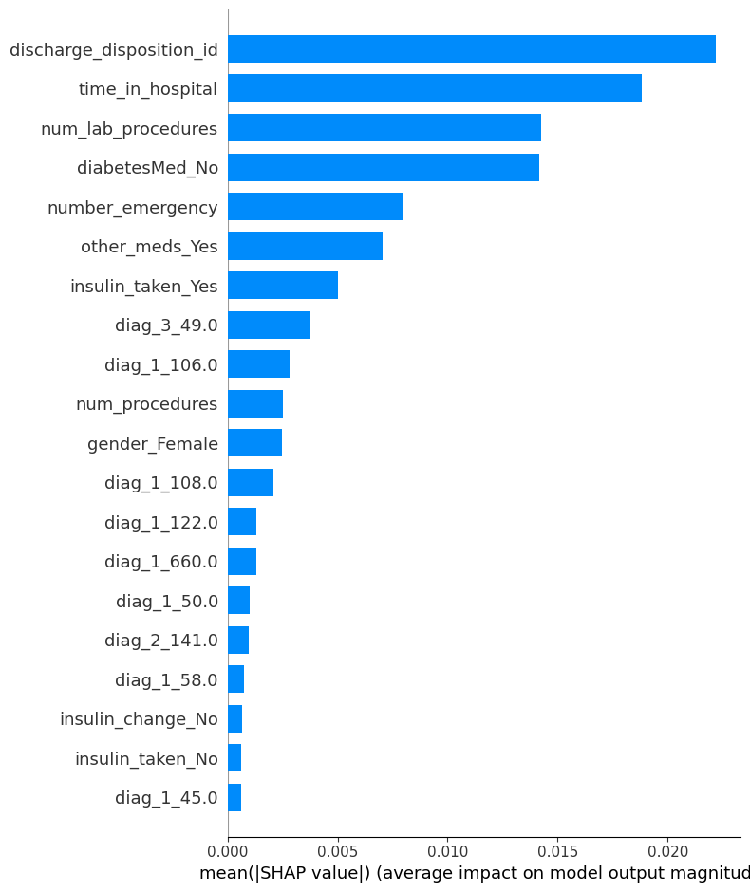
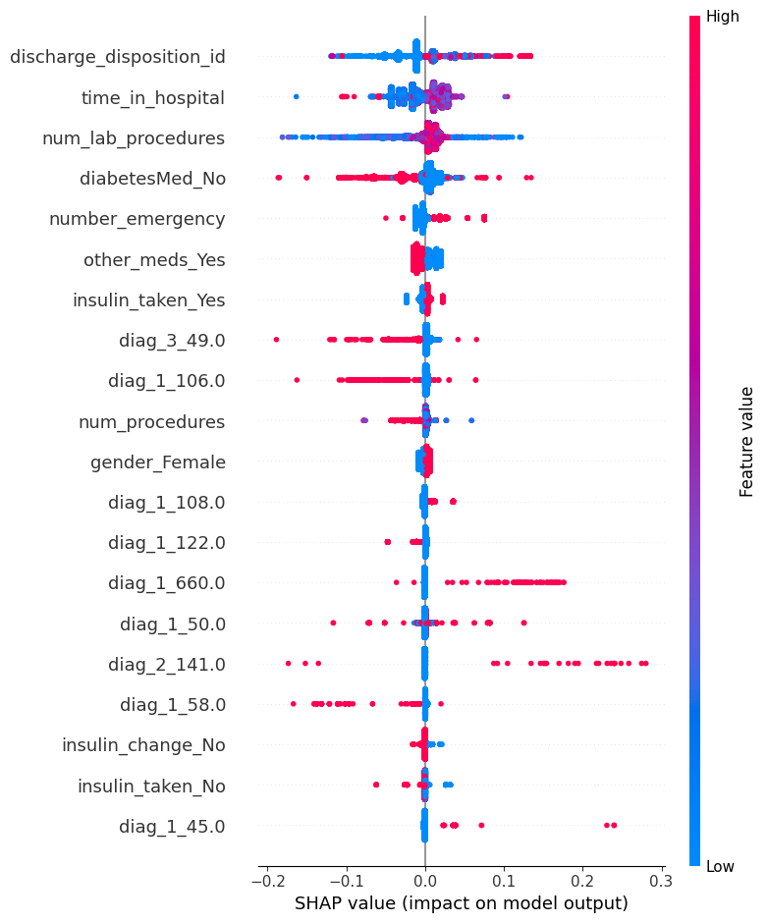
SHAP values
DECISION TREES

Slide 27
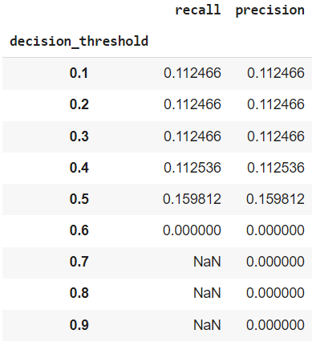
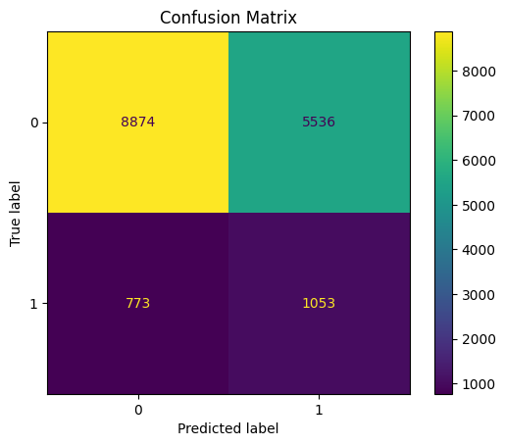
RANDOM FOREST
Accuracy: 0.61
Recall: 0.16
Precision: 0.16
F1-Score: 0.25

Slide 28
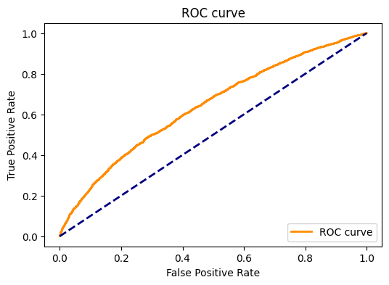
RANDOM FOREST

Slide 29
OVERALL

Slide 30
LOGISTIC REGRESSION
DECISION TREES
RANDOM FOREST
It is better to have false positives than false negatives
It is better to be readmitted…but there are costs!

Slide 31

CONCLUSION & FUTURE WORK
The logistic regression model had the best results in predicting readmission.
False positives VS False negatives…depending on the outcome.
FUTURE WORK:
SHAP linear regression
Fairness and Bias
Random forest – check
Choose the best threshold (COST VS HEALTH)

Slide 32


THANK YOU!
+800
LINES OF CODE!
+250
HOURS DEDICATED
92
COFFES
Made by students from
CATÓLICA MEDICAL SCHOOL:
André Gaspar
Inês Duarte
Madalena Geraldes
Mariana Santos

